Slide 1
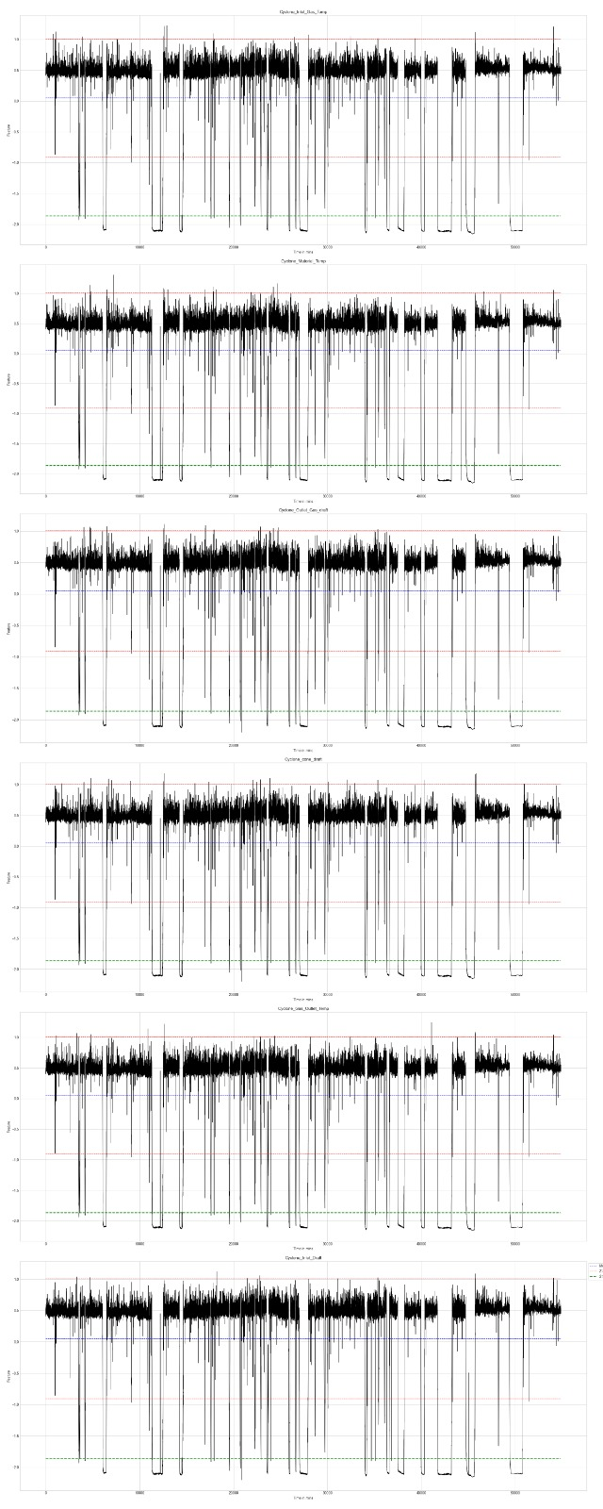
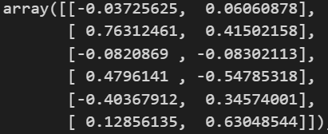
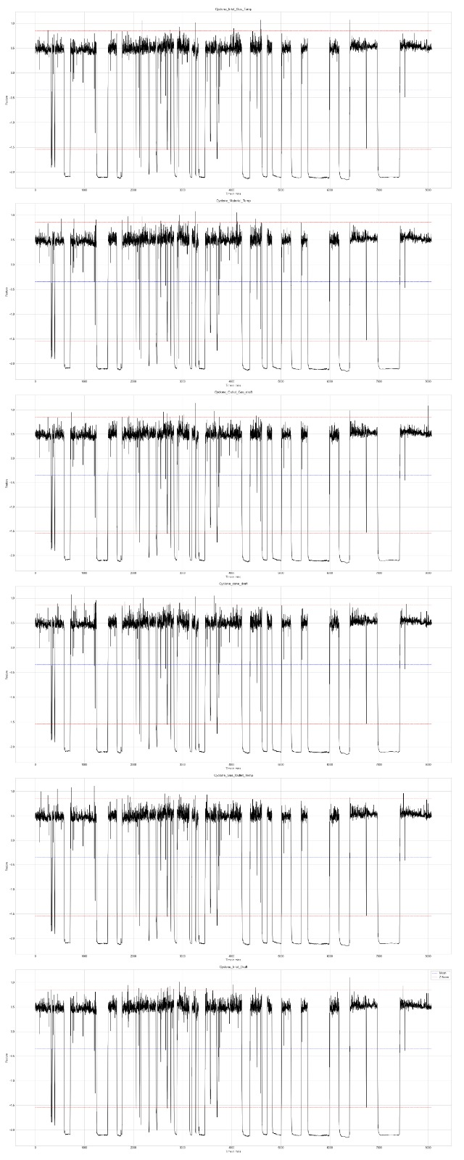


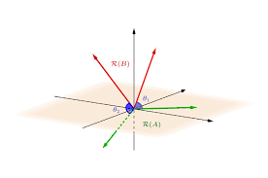
Anomaly Detection In Time Series
Keerthana K M, Sai Disha D, Sowbhagya V Kini
Under the guidance of Prof. Sudarshan N Acharya
AIM
EXPLORATORY DATA ANALYSIS (EDA)
PCA between matrices:
We consider the 30 min observation for anomaly detection , which gives us a 6*6 matrix for each 30 min time stamp. The PCA is measured between two 6*6 matrices, and the components defining maximum variance are considered.
Timestamps under which the powerplant works perfectly five plotted across six features.
To detect anomalies in multivariate time series .
OBJECTIVES
Finding missing values
Convert multivariate to univariate time series using dimensionality reduction techniques.
Detect anomalies in the data throughout all the features.
DATA
The data consists of 6 features and a large number of sensor data , where each time stamp corresponds to 5 minutes.
The data considered has only continuous columns.
continuous_cols
Cyclone_ Inlet _Gas _Temp
Cyclone_Material_Temp
Cyclone_Outlet_Gas_Temp
Cyclone_cone_draft
Cyclone_Gas_Outlet_Temp
Cyclone_Inlet_Draft
Linear Interpolation
Data Cleaning
RESULTS
Anomalies across features
Standardization
PCA
Dimensionality Reduction
METHODOLOGY
Angle between subspaces :
where,
- Angle between subspaces
- Minimum most eigen value
CONCLUSION
The ratio of anomalies to non-anomalies may or may not vary with the change in duration consideration.

